Slide 1
ACT as a brief intervention: 1 verus 7 sessions to treat phobia of enclosed spaces
Vogel, Karen
University of São Paulo
Brazil
Presenter: Saban, Michaele

Slide 2
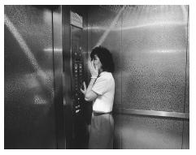
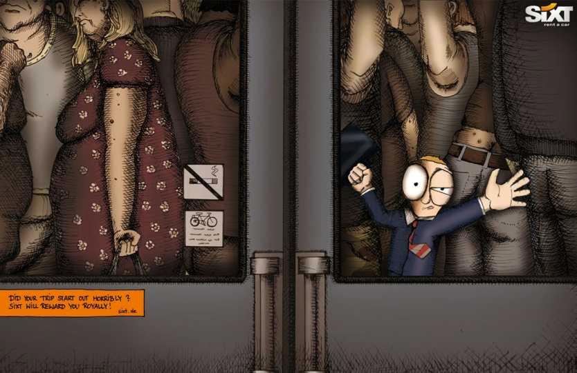
Phobia enclosed spaces
Avoidance of restraint, confinement and asphyxiation situations
Fear of not being able to leave the situation

Slide 3
Our study: fear of MRI

Slide 4
Randomized Controled Trial
26 participants
1 session
N=13
7 session
N= 13
Brief ACT Protocols from: Páez-Blarrina et al. (2008)

Slide 5
Results
1) ACT as a brief intervention was effective to treat
fear of enclosed spaces !
2) 7 sessions: 92 % of participants were able to do a 30 minute exame without anesthesia.
3) More than one session is required for the treatment. The 1 session protocol results were not significant.

Slide 6
Thank you!
More information about this study:
karen@ibmind.com.br
Thanks MIKA for presenting at my place!
Cheers to Ross and Beate!
I wish I could be with you guys!

